Slide 1


Slide 2
MIPS Assembly
Beyond the LMC

Slide 3
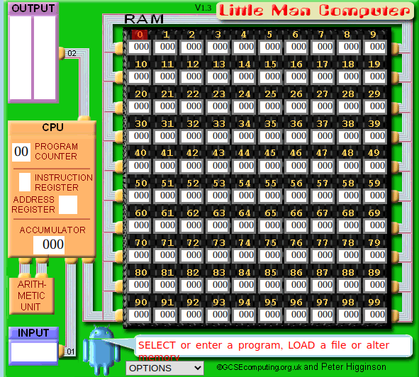
LMC Review
Recall the LMC architecture
Program Counter
Instruction & Address registers
Accumulator register for work
Input/Output areas
An ALU
100 memory slots
Notes:
Can be found online… but I can’t link to it

Slide 4
LMC Review
This is a great teaching tool
Reflects the layout of early hardware
Modern hardware looks different
We will move a step closer to modern hardware with a RISC simulator
Notes:
Can be found online… but I can’t link to it

Slide 5
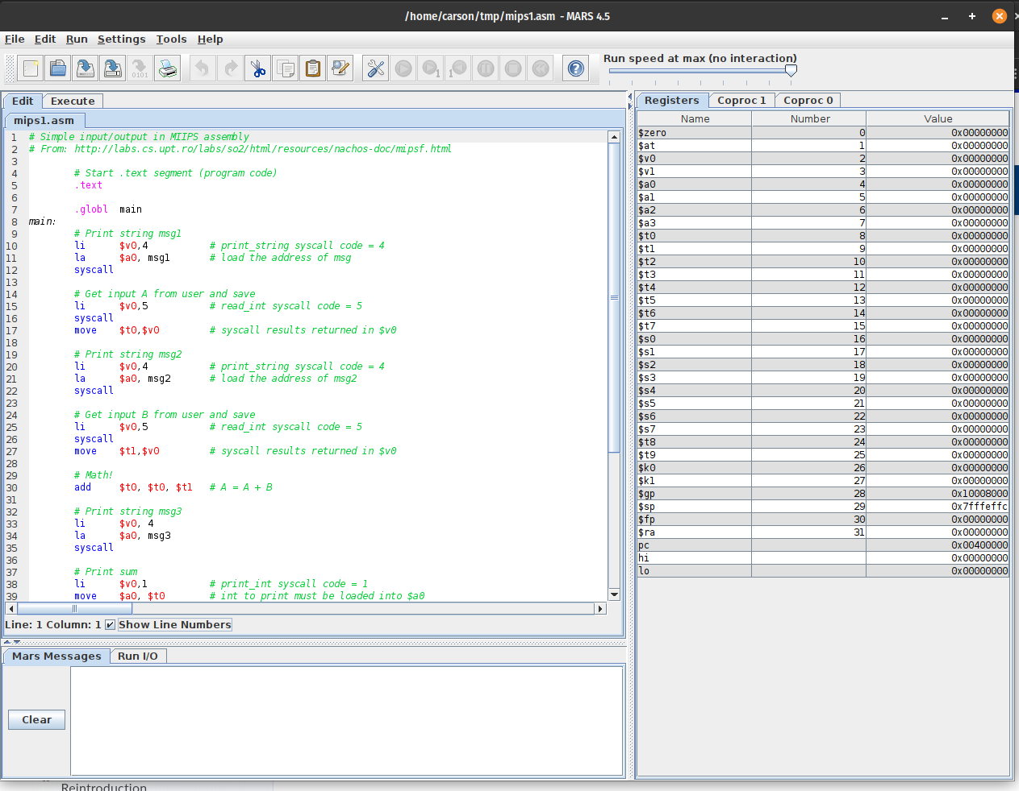
MIPS
We now turn to MIPS, a common teaching RISC architecture
RISC - Reduced Instruction Set Computer
Fewer instructions
More instructions needed to complete tasks
Simpler logic
Compared with CISC - Complex Instruction Set Computer
X86 is CISC
Notes:
Can be found online… but I can’t link to it

Slide 6
MIPS
We will be looking at the 32 bit MIPS architecture
MIPS was introduced in 1985 and is extremely popular in teaching institutions
Despite its popularity in academia, it has not been widely adopted in the commercial space
Notes:
Can be found online… but I can’t link to it

Slide 7
MIPS
Despite not being popular in industry, the architecture has been influential
ARM64, in particular, shares a lot of features with MIPS
ARM32 did not
With the advent of apple’s M chips, MIPS-like ideas are breaking into mainstream computing
Notes:
Can be found online… but I can’t link to it

Slide 8
MIPS
Differences with LMC
MIPS has 32 data registers! vs 1 accumulator
Some registers have special functions, so you can’t use all of them
32 bit memory space
Many more instructions
Notes:
Can be found online… but I can’t link to it

Slide 9
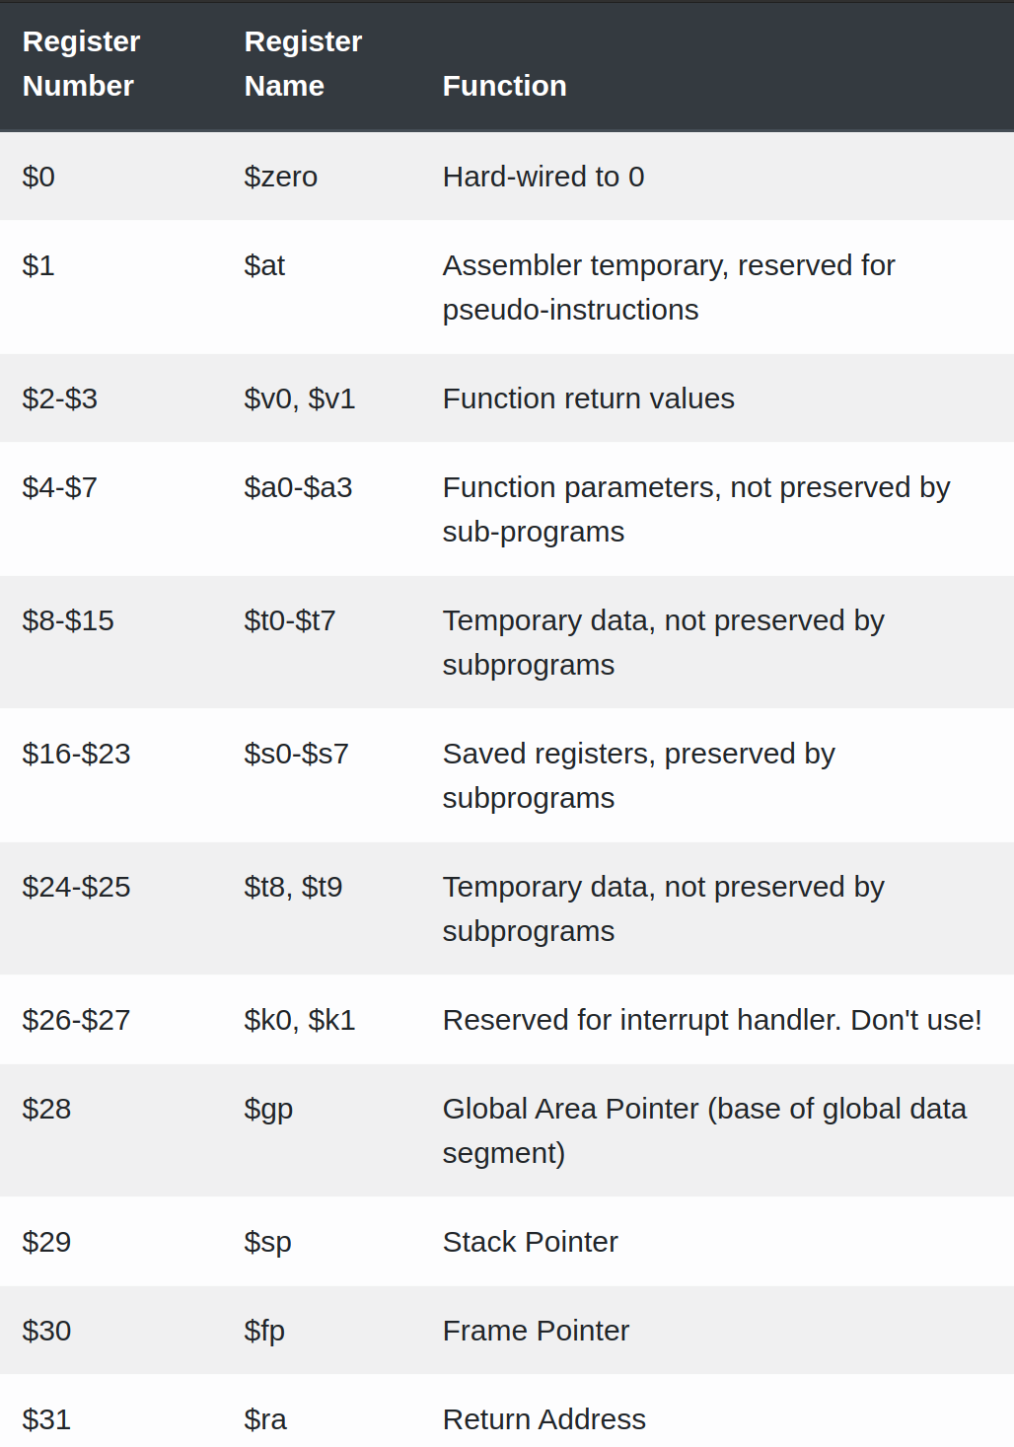
MIPS Registers
Registers have a number as well as a name associated with them
In assembly programming you use the name
$zero is hardwired to zero
$at - temporary, used for pseudo-instructions
Notes:
Can be found online… but I can’t link to it

Slide 10
MIPS Registers
$v0, $v1 - function return values
$a0-a3 - function parameters (not preserved)
$t0-t9 - temporary values (not preserved)
$s0-s7 - temporary values (preserved)
Notes:
Can be found online… but I can’t link to it

Slide 11
MIPS Registers
$k0, $k1 - used for interrupt handling by the OS & hardware, DO NOT USE
$gp - global area pointer (points to heap memory)
$sp - stack pointer (points to stack memory)
Notes:
Can be found online… but I can’t link to it

Slide 12
MIPS Registers
$fp - Frame pointer (related to the stack pointer)
$ra - Return address (will make sense when we talk about how function calls work)
Notes:
Can be found online… but I can’t link to it

Slide 13
MIPS
We will be using the MARS MIPS emulator
Written in Java
Provides an editor with some autocompletion
Allows you to step through assembly instructions and see what’s happening in the computer
Notes:
Can be found online… but I can’t link to it

Slide 14
MIPS
Similarities to LMC
Same basic instruction cycle
Fetch instruction
Decode
Execute
Increment Program Counter register (PC)
The PC is visible in the MARS UI
Notes:
Can be found online… but I can’t link to it

Slide 15
MIPS
Similarities to LMC
MIPS is a Load/Store architecture
Data must be loaded into a register from memory
Mutation operations (+, -, etc.) are performed only between registers
Data is then stored back to memory
Notes:
Can be found online… but I can’t link to it

Slide 16
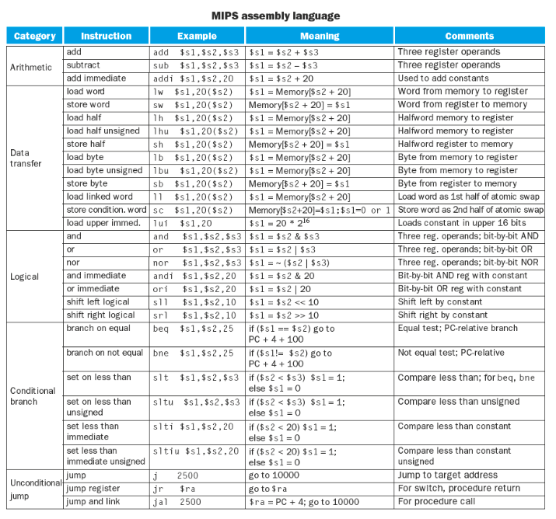
MIPS Basic Instructions
MIPS Instructions come in three major flavors:
R format (registers) - three register arguments
I format (immediate) - two register arguments + an immediate value
J format (jump) - no register arguments, 26 bits for address information
Notes:
Can be found online… but I can’t link to it

Slide 17
MIPS Basic Instructions
MIPS Instructions
LW - load 32-bit word to register
SW - store from register
ADD, SUB - signed math operators
Immediate versions too
MOVE - copy from register to register
MOVE is a pseudo instruction and becomes an ADD under the covers
Notes:
Can be found online… but I can’t link to it

Slide 18
MIPS Basic Instructions
MIPS Instructions
AND, OR, NOR - bitwise logical operators
Immediate versions available as well
Notes:
Can be found online… but I can’t link to it

Slide 19
MIPS Immediates
Immediates
I-style instructions
Values are encoded in the instruction directly
Only two registers are involved in the computation: ADDI $v0, $v0, 1 “Add one to the value in $v0 and save it back to $v0”
Notes:
Can be found online… but I can’t link to it

Slide 20
MIPS Branch Instructions
Branch Instructions in MIPS
BEQ - Branch On Equal
BNE - Branch On Not Equal
J - Jump
JAL - Jump and link (function related)
JR - Jump based on the value of a register
Notes:
Can be found online… but I can’t link to it

Slide 21
Pseudo-instructions
Many common instructions in MIPS assembly do not correspond 1-1 with machine instructions
Rather, they are transformed into other instructions
These are called pseudo-instructions
Notes:
Can be found online… but I can’t link to it

Slide 22
Psuedoinstructions
To the assembly programmer, they look and act like regular instructions
They make working in MIPS assembly more pleasant, without adding additional complexity to the circuitry
Notes:
Can be found online… but I can’t link to it

Slide 23
Psuedoinstructions
Examples:
MOVE
BLT - Branch Less Than
BGT - Branch Greater Than
…
LI - Load immediate value
LA - Load address
For example LI $v0, <value> becomes ADDI $v0, $zero, <value>
Notes:
Can be found online… but I can’t link to it

Slide 24
MIPS
So, a lot more going on, but the basics of assembly remain the same
A lot of the complexity here is around supporting function calls, which we will discuss in our next lecture
Notes:
Can be found online… but I can’t link to it

Slide 25
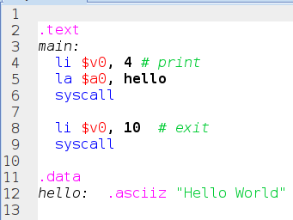
I/O In MIPS
Note that unlike LMC, we do not have instructions for getting input directly from the user
Instead, to do this, we will need to make system calls
This is a more realistic model for modern computers
Notes:
Can be found online… but I can’t link to it

Slide 26
System Calls
A syscall in general is a call to the system (typically the OS) to perform some computation
This is typically done with some sort of calling convention
A register is used to select which system call to make
Arguments are passed via standard registers
Recall on MIPS, $a0-a4
Notes:
Can be found online… but I can’t link to it

Slide 27
Storing Data
MIPS, like most modern assembly, splits code and data off into a separate areas
.text is a code area
.data is a data area
Note that labels work as they do in LMC
The LA instruction loads the address of a given label
Notes:
Can be found online… but I can’t link to it

Slide 28
I/O In MIPS
So, here we have a simple “Hello World” assembly program
We load the immediate value 4 into $v0
$v0 communicates which system call to make
We then load the address of the string into $a0, to pass through to the system
Notes:
Can be found online… but I can’t link to it

Slide 29
I/O In MIPS
Finally we invoke the syscall instruction, which passes control over to the system
The next line sets $v0 to 10, which is the system exit code and invoke the system once again, which ends the program
Notes:
Can be found online… but I can’t link to it

Slide 30
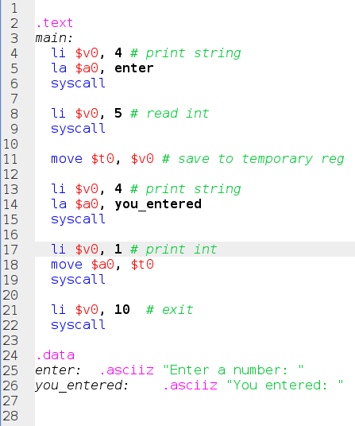
I/O In MIPS
Not so bad, right?
OK, how do we get input?
Another syscall
System call 5: read int
Results are saved to $v0
We move this value to a temp register so we can then print out a new string, and then the integer that was entered...
Notes:
Can be found online… but I can’t link to it

Slide 31
I/O In MIPS
You can find all the syscalls available in MARS either in the Help menu, or online here: http://courses.missouristate.edu/KenVollmar/MARS/Help/SyscallHelp.html
Notes:
Can be found online… but I can’t link to it

Slide 32
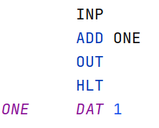
MIPS Add One
Let’s implement some of our LMC programs in MIPS
Recall the LMC implementation for “Add One”
Notes:
Can be found online… but I can’t link to it

Slide 33
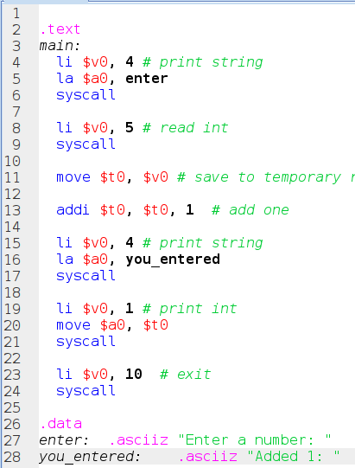
MIPS Add One
Pretty much the same as our previous MIPS example
We add the ADDI instruction to add an immediate value to the temporary register we are storing the value in
A lot more book keeping, but this is much more realistic assembly
Notes:
Can be found online… but I can’t link to it

Slide 34
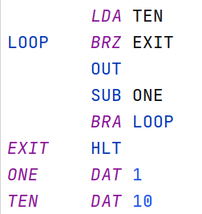
MIPS Count Down
Print the numbers 10 to 1 in decreasing order
LMC Code
Notes:
Can be found online… but I can’t link to it

Slide 35
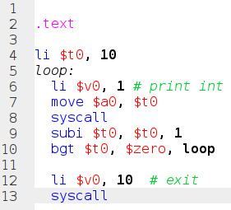
MIPS Count Down
MIPS Implementation
Move 10 into $t0
Print via a syscall
Subtract 1 from $t0 (using an immediate value)
Branch back to the loop if $t0 is greater than zero
Note that immediates make things clearer
Notes:
Can be found online… but I can’t link to it

Slide 36
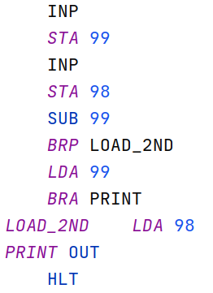
MAX
Max: “Ask the user for two numbers and print the maximum of the two”
Recall that this was difficult in LMC because we had two values plus a difference value in play
Requires storing working data to memory
Notes:
Can be found online… but I can’t link to it

Slide 37
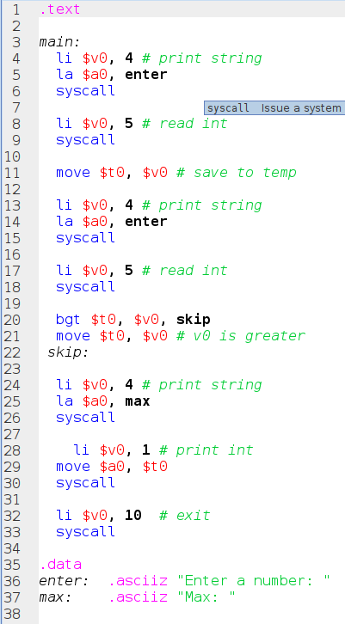
MIPS MAX
Ask for two numbers via syscalls
The crux is at line 20, where we only move the result of the second syscall into $t0 if it is greater than the current value in $t0
Otherwise we jump over to the skip label
Notes:
Can be found online… but I can’t link to it

Slide 38
MIPS MAX
A little more difficult than LMC, but note that we didn’t have to deal with memory at all
More registers means things are easier in this regard
Notes:
Can be found online… but I can’t link to it

Slide 39
MIPS
OK, that’s a brief introduction to MIPS assembly code
More realistic model of modern computers (still not perfect!)
Many more registers than LMC
Many more instructions
Especially the branching logic
Immediate values available with instructions
Syscalls for interacting with the system
Again, remember: IT’S JUST CODE

